Slide 1
TicTacToi in python with Tkinter
Mahmoud Mabrouk

Slide 2
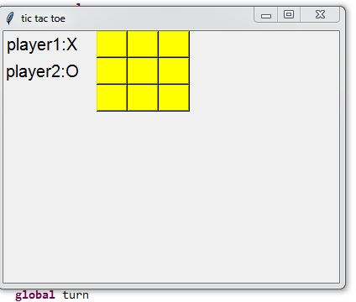
App Outline

Slide 3
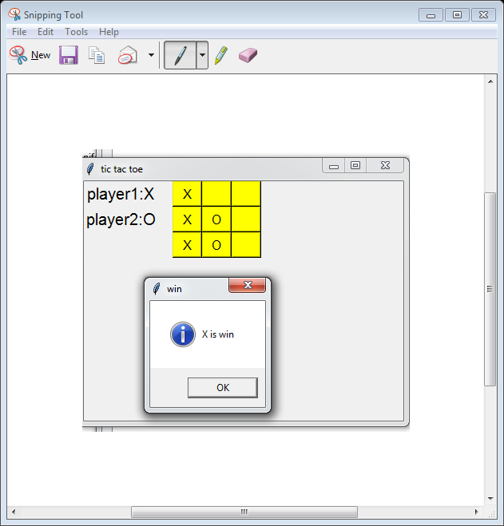
App Component
Tkinter
Window
Buttons
Lablels
MessageBox

Slide 4
Button
btn=Button(wind,text=" ",bg="yellow",fg="black",width=3,height=1,font='Helvetiica',command=clicked9)
btn.grid(row=2,column=3)
Window
Style(Foreground color, background color , width , heright , font )
Command (what to do when clicked)
Position in layout

Slide 5
MessageBox
Dialoge box with message will be used to display the winner of game
messagebox.showinfo("win", player +" is win")
Title of dialoge
Message

Slide 6
global
We use global keyword to indicate that we deal with global variable
# check
turn = 1
def check():
global turn
turn +=1

